Slide 1
Integrating HCL Domino Applications with GPT using Python and the OpenAI API Library

Slide 3
Presenter
Erik Werfel
Senior DevOps Engineer, Fragomen, Del Rey, Bernsen & Loewy
erik@werfel.net
https://github.com/ewerfel/collabsphere
https://medium.com/@erikwerfel

Slide 4
Components
HCL Notes Client
Python
Jupyter Notebook
ChatGPT Jupyter AI Assistant
COM
API account with OpenAI
BeautifulSoup to parse information from a web page

Slide 5
Why Jupyter Notebook
JupyterLab is a web-based interactive computing environment.
Jupyter Notebook allows you to run code in individual cells while showing output and retaining variables in memory.
Can quickly make small changes and see the effect.
Notebook allows explanatory cells as well as code cells, and are easily shared.

Slide 6
COM Objects
Uses Component Object Model
Not new technology
(Possibly) Windows only
Notes client must be installed
Should use 32-bit COM object (to match Notes client)
All Notes objects must be derived from NotesSession (can’t instantiate other Notes objects)

Slide 7
Install Jupyter notebook
Download and install Python:
https://www.python.org/downloads/
Install Jupyter
pip install jupyterlab
Install Jupyter Notebook
pip install notebook

Slide 8
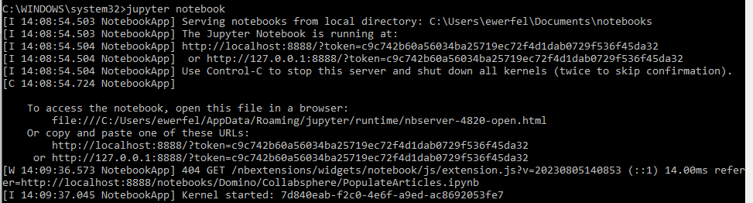
Starting Jupyter
Go to the command prompt
Enter command:
jupyter notebook
Jupyter will run in current window, and should open a page in your browser

Slide 9
ChatGPT Jupyter AI Assistant
Plugin that provides access to ChatGPT from Jupyter.
https://chrome.google.com/webstore/detail/chatgpt-jupyter-ai-assist/dlipncbkjmjjdpgcnodkbdobkadiejll
The plugin is not required, but will add these buttons:
Explain, Debug, Review, Complete
The Debug button is especially useful.
Explains errors, and often writes corrected code.

Slide 10
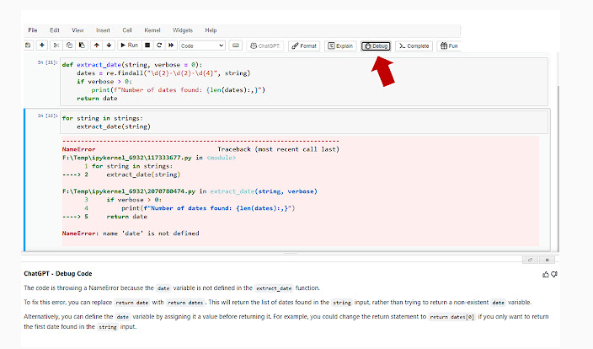

Slide 11
Get an OpenAI API Key
Create an API account at openai.com
API accounts are not free, pay by usage, but inexpensive
Go to https://platform.openai.com/account/api-keys to generate a key. (Keys can only be accessed once, so keep it safe or generate a new one.)

Slide 12
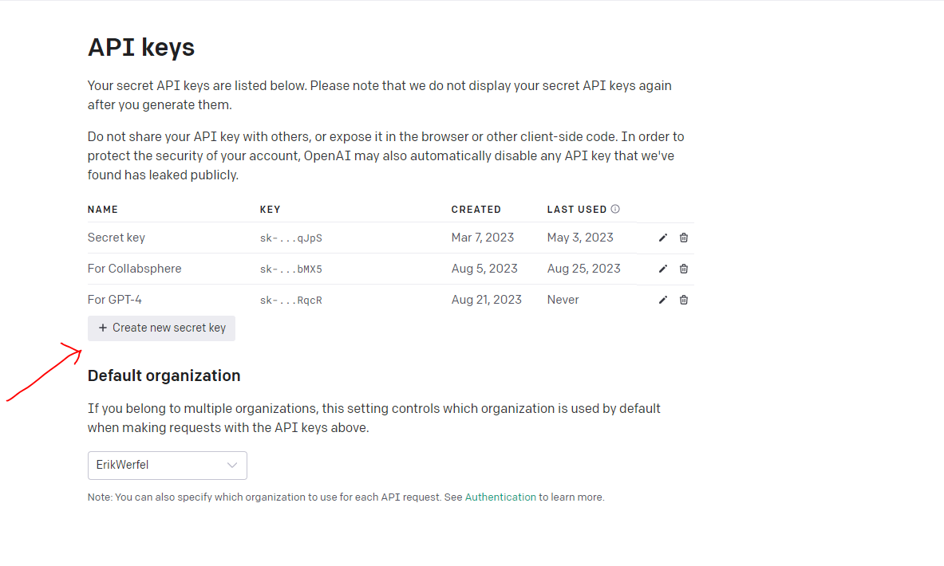
Get an API Key

Slide 13
Necessary libraries
COM library for Python
Pandas is the Python data analysis library, needed for dataframes, used to store and manipulate tabular data.
import win32com.client
import pandas as pd

Slide 14
News Category Dataset
News Category dataset has headlines from 2012 to 2022 from HuffPost.
Download from:
https://www.kaggle.com/datasets/rmisra/news-category-dataset?resource=download

Slide 15
News Category Dataset
Fields in the data
category
headline
authors
link
short_description
date

Slide 16
COM Essentials
notesSession = win32com.client.Dispatch('Notes.NOTESSESSION')
myDb = notesSession.GetDatabase(“[Server]", "[path\to\database]")
myview = myDb.GetView("MyView")
myDoc = myView.GetFirstDocument
print(myDoc.UniversalId)
Get a NotesSession COM object
Derive a NotesDatabase COM object from the session
Get a view from the database
Get the first document from the view

Slide 17
Use BeautifulSoup to Retrieve the Body
storiesDf = pd.read_json(r’c:\path\stories.json')
def retrieveArticle(articleURL):
# URL of the web page you want to scrape
# Send a request to fetch the web page content
response = requests.get(articleURL)
# Parse the HTML content using BeautifulSoup
soup = BeautifulSoup(response.content, 'html.parser')
# Find the <article> tag and extract its contents
article_tag = soup.find('article')
if article_tag:
article_content = article_tag.get_text()
else:
article_content = 'No article tag found on the page.'
return article_content

Slide 18
Populate a Domino application
storiesDf['articleBody'] = storiesDf['link'].apply(retrieveArticle)
formName = "Article"
for index, row in storiesDf.T.items():
doc = articlesDb.CreateDocument
doc.ReplaceItemValue("Form",formName)
for i in range(len(row)):
doc.ReplaceItemValue(row.index[i], row[i])
doc.Save(1,1)

Slide 19
Demo – Populating a Database

Slide 20
Get all items from a document
myDict = {}
unid = doc.UniversalId
myDict['unid']=unid
myDict['notesLink']=makeNotesLink(unid,replicaId)
for item in doc.Items:
name = item.name
if name[:1]!="$":
value = item.values[0]
myDict[name] = value
newRow = pd.DataFrame(myDict,index=[unid])
articlesDf = articlesDf.append(newRow)
Create an empty dictionary
Loop through all Items in the document, adding name value pairs to the dictionary.
Create a dataframe with one row from the dictionary.
Append the dataframe with the new row to the existing dataframe. (Columns will be added if necessary.)

Slide 21
Retrieve all documents into a dataframe
view = articlesDb.GetView("Articles")
doc = view.GetFirstDocument
articlesDf = pd.DataFrame()
while not doc is None:
myDict = {}
unid = doc.UniversalId
myDict["unid"] = unid
for item in doc.Items:
value = item.values[0]
myDict[item.name] = value
newRow = pd.DataFrame(myDict, index=[unid])
articlesDf = articlesDf.append(newRow)
doc = view.GetNextDocument(doc)
Create an empty dataframe
Walk the view
For each document, create a dictionary (key/value pairs) with the name of each item and its value
Add the dictionary to the dataframe

Slide 22
Explore the dataframe
df.head(10) Show the first 10 rows
df.tail(10) Show the last 10 rows
df.shape Show the number of rows and columns
df.dtypes Show the datatype of each column
df.describe() Summarize statistical information about the dataframe

Slide 23
Examine the data
dataframe.loc can take a Boolean series and filter to rows matching true values
Set of rows/documents in WORLD NEWS category:
articlesDf.loc[articlesDf['category’]=="WORLD NEWS"]
Number of rows/documents in WORLD NEWS category:
len(articlesDf.loc[articlesDf['category']=="WORLD NEWS"])
Percentage of rows/documents in the WORLD NEWS category:
ratio =len(articlesDf.loc[articlesDf['category']== WORLD NEWS']) / len(articlesDf)
print(f"{ratio:.0%}")

Slide 24
Set the OpenAI api_key
import openai
api_key = "sk-xLLDOMGfhdBlbkFJYNWBeqUNcDKY1uJwbMX5"
openai.api_key = api_key

Slide 25
Generate text from a prompt
def generate_text(prompt):
response = openai.ChatCompletion.create(
model="gpt-4",
top_p=0.1,
messages=[
{
"role": "system",
"content": "You are a knowledge management professional.",
},
{
"role": "user",
"content": prompt,
},
],
temperature=0.7,
max_tokens=150, # Adjust the number of tokens in the response
stop=None, # If you want to stop the response at a specific string
)
if response and 'choices' in response and response['choices'][0]:
return response['choices'][0]['message']['content']
else:
return "No response received."

Slide 26
def getGeneratedText(articleBody, prompt):
generated_text = generate_text(prompt + ": " + articleBody)
return generated_text
def getSummary(articleBody):
prompt = "Describe this story in 25 words or less. The response must be 25 words or less: "
generated_text = getGeneratedText(articleBody,prompt)
return generated_text

Slide 27
Iterate the dataframe and populate AI response
def populateDocumentsWithAIResponse(fieldName , func):
# iterate through all rows in articlesDF
for index, row in articlesDf.iterrows():
# retrieve the articleBody to pass to ChatGPT
articleBody = row['articleBody']
# the dataframe index is the doc unid
unid = index
# call the function passing the article body
result = func(articleBody)
#get a handle to the matching Notes document, and update the field with the result
doc = articlesDb.getDocumentByUnid(unid)
doc.ReplaceItemValue(fieldName, result)
doc.Save(1, 1)
#update the dataframe with the result
articlesDf.loc[unid,fieldName]=result
populateDocumentsWithAIResponse('summaryInSpanish', getSummaryInSpanish)

Slide 28
Demo—Working with ChatGPT

Slide 30
Presenter
Erik Werfel
Senior DevOps Engineer, Fragomen, Del Rey, Bernsen & Loewy
erik@werfel.net
https://github.com/ewerfel/collabsphere
https://medium.com/@erikwerfel

